Slide 1



GRT INSTITUTE OF
ENGINEERING AND
TECHNOLOGY, TIRUTTANI - 631209
Approved by AICTE, New Delhi Affiliated to Anna University, Chennai
DEPARTMENT OF ELECTRONICS AND COMMUNICATION ENGINEERING
Accredited by NBA, New Delhi
SMART CITIES MANHOLE COVER MANAGEMENT SYSTEM BASED ON IOT EDGE COMPUTING
MODEL - REVIEW (11/05/2023)
Batch No. - XI
Present By:-
1. HEMANTH R - 110319106013
2. KARTHIK A K - 110319106016
3. NITHISH KUMAR V R - 110319106031
Guided By.
Dr.P.SIVAKUMAR,ME.P.hd.,
Professor
Department of Electronics and Communication Engineering

Slide 2
TABLE OF CONTENT :
OBJECTIVE
INTRODUCTION
ABSTRACT
LITERATURE SURVEY
LITERATURE SURVEY
LITERATURE SURVEY
LITERATURE SURVEY
PROPOSED WORK
BLOCK DIAGRAM
PROBLEM IDENTIFICATION & FORMULATION
BLOCK DIAGRAM EXPLANATION
REQUIREMENGTS
EXPERIMENT TESTING
HARDWARE TESTING
SOFTWARE TESTING
CONCLUSION
ADVANTAGE
APPLICATION
GRTIET, Department of Electronics and Communication Engineering

Slide 3
OBJECTIVES
In an edge computing-based manhole cover management system enables real-time monitoring of the status of manhole covers. The IoT sensors can detect changes in the status of the manhole covers, such as if a cover is open or closed, and send this information to the edge computing system.
This early detection can prevent accidents and reduce the risk of injury to citizens, making cities safer.
By analyzing the data collected from sensors and GSM, the system can predict potential failures in manhole covers and generate alerts for preventive maintenance
GRTIET, Department of Electronics and Communication Engineering

Slide 4
INTRODUCTION
An integral part of any drainage system is the access points into it when it comes to cleaning, clearing, and inspection. Metropolitan cities have adopted underground drainage system and the city’s municipal corporation must maintain its cleanliness. If the sewage maintenance is not proper, ground water gets contaminated causing infectious diseases.
Blockages in drains during monsoon season, causes problems in the routine of the public. Hence, there should be a facility in the city’s corporation, which alerts the officials about blockages in sewers, their exact location.
It mainly acknowledges in the field of alerting the people about the gas explosion, increase in the water level and the temperature level. It uses IoT to make the drainage monitoring system in a highly automotive by using sensor for detecting and sending alerts through GSM to the authorities.
This project overcomes the demerits by detecting drainage water blockage by installing water flow rate sensors at the intersection of nodes. When there is a blockage in a particular node, there is variation in the flow of drainage water which when cross the set value will display the alert in the managing station. Also other demerits are solved by detecting temperature variations inside the manhole and alerting the same to the managing station.
Also, flow rate sensors are used to detect the over flow of the drainage water and alerting the same to the managing station through automatic message.
GRTIET, Department of Electronics and Communication Engineering

Slide 5
ABSTRACT
A smart city is the future goal to have cleaner and better for the society. Smart underground infrastructure is an important feature to be considered while implementing a smart city. Drainage system monitoring plays a vital role in keeping the city clean and healthy. Since manual monitoring is incompetent, this leads to slow handling of problems in drainage and consumes more time to solve. To mitigate all these issues, the system using a wireless sensor network, consisting of sensor nodes is designed. The system also provides a real-time alert to the relevant authorities, enabling them to take immediate action The proposed system is low cost, low maintenance Internet of Things (IoT) devices, and artificial intelligence algorithms based real time which alerts the managing station through an email / message when any manhole crosses its threshold values and to check whether a manhole cap is open or closed . This system reduces the death risk of manual scavengers who clean the underground drainage and also benefits the public.
Keywords: Arduino, edge-computing, Manhole management, Smart cities, IOT.
GRTIET, Department of Electronics and Communication Engineering

Slide 6
LITERATURE SURVEY
REVIEW PAPER 1:
MANHOLE COVER INTELLIGENT DETECTION AND MANAGEMENT SYSTEM
Author : Xinru Fu
Journal :Atlantis Press
Year of Published : 2016
DISCRIPTION:
In order to avoid the risks that imperfect manhole cover and feature to bring, this paper, aiming at the existing problem of manhole cover, proposed a detectable and maintainable regionalization covers intelligent security management system.
Many sensors set up in the manhole cover to real-time monitor its situation, Through MCU、RF Wireless Data Communication Module and upper computer to understand and control manhole cover,
this system could monitor the city manhole cover in real time and give an alarm automatically.
DRAWBACK : Can’t able to sent message.
GRTIET, Department of Electronics and Communication Engineering

Slide 7
LITERATURE SURVEY
REVIEW PAPER 2:
SECURE MANHOLE MONITORING SYSTEM EMPLOYING SENSORS AND GSM TECHNIQUES
Author : Nataraja N, Amruthavarshini R, Chaitra N L , Jyothi K , Krupaa N, S S M Saqquaf
Journal :IEEE Xplore
Year of Published: 2018
DISCRIPTION:
Manhole explosions are major threat in recent days. Manhole cover opening leads to accidental fall of vehicles, pedestrians leading to accidents or loss of life.
Manhole opening detection and alerting is mainly based on detecting the manholes which are opened due to overflow of sewage / rain water during heavy rainfall and alerting.
When a manhole opening is detected either due to overflow of sewage water, increase in pressure or temperature, it leads to the breakage of the manhole lids.
To avoid such incidents even before it could affect the public, an alerting system is built wherein the buzzer alerts the surrounding and sends the sensed data to the managing authorities using GSM techniques. So, they can take precautionary action to close the manhole considering public safety.
DRAWBACK :
Main disadvantage is unable to store maintenance database .
In this Project can’t able to track the perticular
GRTIET, Department of Electronics and Communication Engineering

Slide 8
LITERATURE SURVEY
REVIEW PAPER 3:
IOT BASED AUTOMATED MANHOLE DETECTION
Author : Dr.T.Menakadevi , Akash.M , Dilip kumar.B , Kannan.M , Chandra Mohan.S
Journal :International Research Journal of Engineering and Technology (IRJET)
Year of Published : 2021
DISCRIPTION: - Smart underground infrastructure is an important feature to be considered while implementing a smart city. Drainage system monitoring plays a vital role in keeping the city clean and healthy. Since manual monitoring is incompetent, this leads to slow handling of problems in drainage and consumes more time to solve. To mitigate all these issues, the system using a wireless sensor network, consisting of sensor nodes is designed. The proposed system is low cost, low maintenance IoT based real time which alerts the managing station through an email when any manhole crosses its threshold values.
DRAWBACKS : Unable to store maintenance database and manhole Cover can’t close automatically
Need internet access.
GRTIET, Department of Electronics and Communication Engineering

Slide 9
PROBLEM IDENTIFICATION AND FORMULATION
PROBLEM IDENTIFICATION :
Need Internet access.
All of the maintains data won't be stored in the current system.
There is no flow sensor to detect the flow of water.
The flow of manhole waters cannot be detected in any previous papers.
FORMULATION :
No need of Internet access.
Edge computing can store the manhole maintenance data.
Flow of water can be detected
Blockage of water also detected by flow sensor.
GRTIET, Department of Electronics and Communication Engineering

Slide 10
PROPOSED WORK
In the proposed method, development of IoT based drainage and manhole monitoring system is designed. This system monitors temperature, manhole lid position whether it will opened or close.
Maximum levels are set and sensors keep monitoring the changing conditions. As the levels reach a maximum set point the sensors detect and send the signal to controller, where it commands the IoT network to generate alerts to the “Municipal Corporation”.
Gas sensor will monitor the toxic gases, Flow sensor will detect the Flow rate of the manhole water, hence the water flow blockage also easily detected.
DHT11 sensor will monitor the Temperature and humidity. If any of the sensor data increases greater than threshold value then GSM (Global System for Mobile communication) will send the message to Municipal Corporation and buzzer will give alerts.
In This proposed solution user doesn’t need to have internet access in his device to get update from this manhole Monitoring & detection system
GRTIET, Department of Electronics and Communication Engineering

Slide 11
BLOCK DIAGRAM
Power Supply
Cloud Server
Gas Sensor
Arduino
UNO
IR Sensor
GSM/GPRS
Ultrasonic
Sensor
Mobile
Flow Sensor
DHT11
LCD
GRTIET, Department of Electronics and Communication Engineering

Slide 12


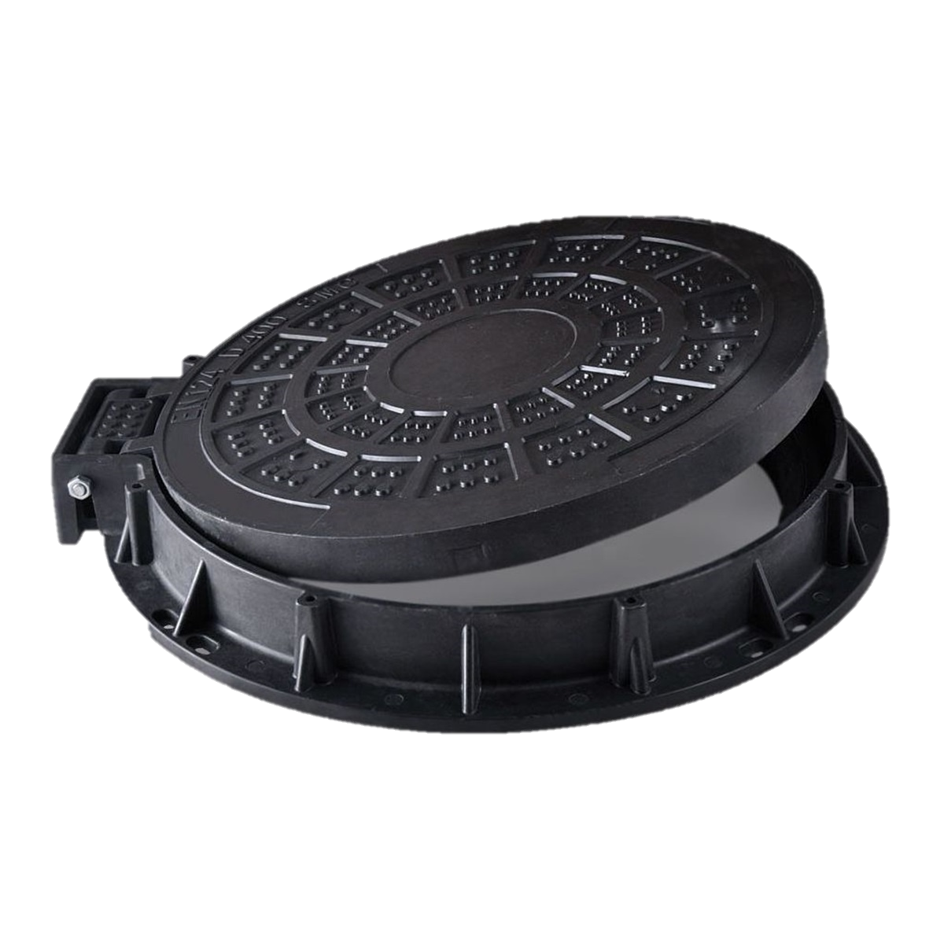
Cloud Server
Municipal Corporation
Municipal Corporation
MANHOLE COVER MANAGEMENT SYSTEM
GRTIET, Department of Electronics and Communication Engineering

Slide 13
REQUIREMENTS
HARDWARE REQUIREMENTS | SOFTWARE REQUIREMANTS
Arduino | Arduino IDE
Gas sensor (MQ2) | Programed by C
IR sensor
Ultrasonic Sensor
Flow Sensor
GSM/GPRS module
LCD
DTH11 Sensor
Buzzer
GRTIET, Department of Electronics and Communication Engineering

Slide 14
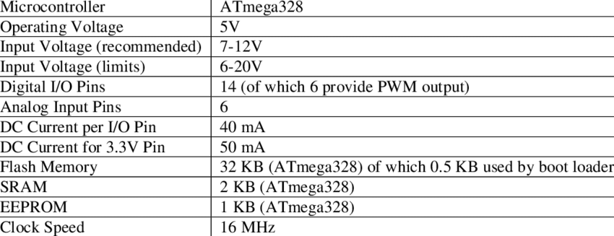
ARDUINO
Arduino is an open-source electronics platform based on easy-to-use hardware and software.
GRTIET, Department of Electronics and Communication Engineering

Slide 15
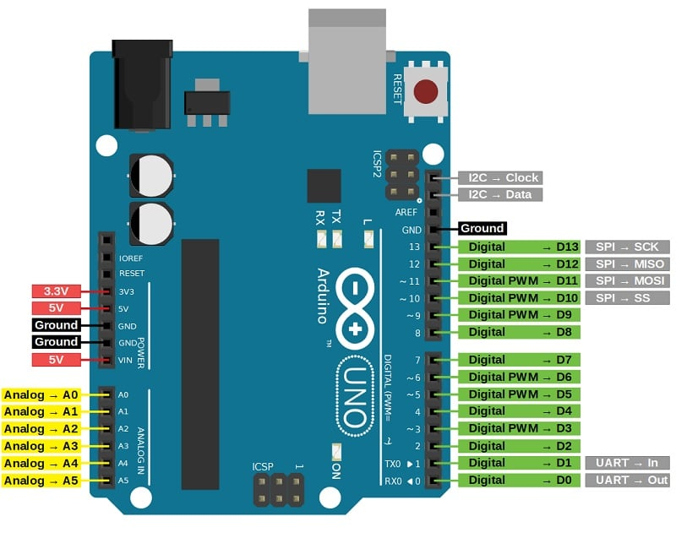
ARDUINO
Pin Category | Pin Name
Power | Vin, 3.3V, 5V, GND
Reset | Reset
Analog Pins | A0 – A5
Input/Output Pins | Digital Pins 0 - 13
Serial | 0(Rx), 1(Tx)
External Interrupts | 2, 3
PWM | 3, 5, 6, 9, 11
SPI | 10 (SS), 11 (MOSI), 12 (MISO) and 13 (SCK)
Inbuilt LED | 13
TWI | A4 (SDA), A5 (SCA)
AREF | AREF
GRTIET, Department of Electronics and Communication Engineering

Slide 16
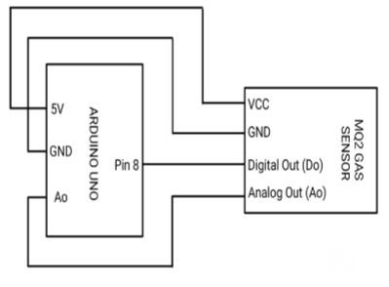
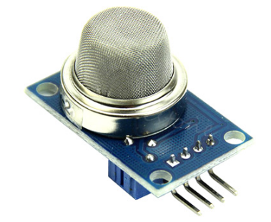
GAS SENSOR
The MQ-2 is a smoke and combustible gas sensor from Winsen. It can detect flammable gas in a range of 300 - 10000ppm
Working principle
The MQ-2 type smoke sensor is made of a tin dioxide semiconductor gas sensing material. When it works at a temperature of 200 to 300 °C, the tin dioxide adsorbs the oxygen in the air, which reduces the density of electrons on the semiconductor and thus increasing the resistance.
Connecting pins
GRTIET, Department of Electronics and Communication Engineering

Slide 17
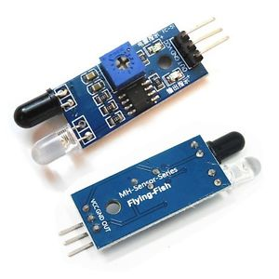
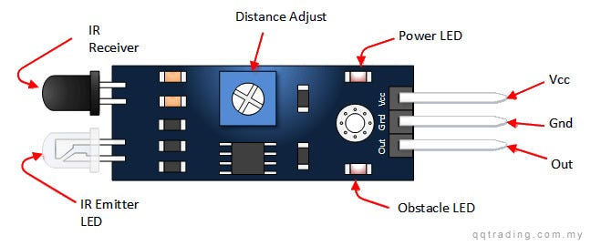
IR SENSOR
An infrared sensor is an electronic device, which emits in order to sense some aspects of the surroundings. An IR sensor can measure the heat of an object as well as detects the motion.
#define IR_SENSOR_PIN 5
VCC -> 5V
GND -> GND
OUT -> pin 1
GRTIET, Department of Electronics and Communication Engineering

Slide 18
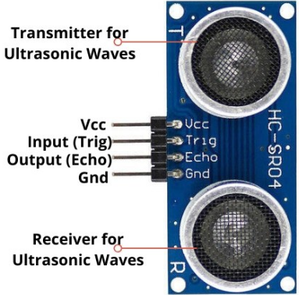
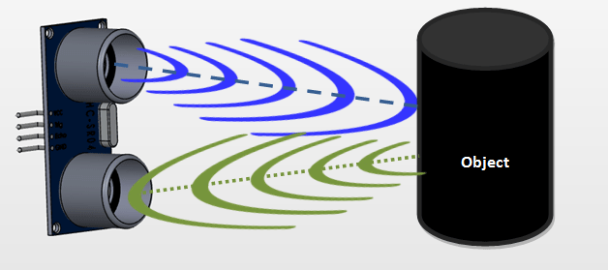
ULTRASONIC SENSOR
An ultrasonic sensor is an electronic device that measures the distance of a target object by emitting ultrasonic sound waves, and converts the reflected sound into an electrical signal. Ultrasonic waves travel faster than the speed of audible sound (i.e. the sound that humans can hear
#define ULTRASONIC_TRIG_PIN 6
#define ULTRASONIC_ECHO_PIN 7
Distance = Speed × Time
GRTIET, Department of Electronics and Communication Engineering

Slide 19
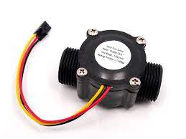

FLOW SENSOR
A flow sensor is a component that measures the flow of a fluid such as a gas or liquid. Flow sensors utilize both mechanical and electrical subsystems to measure changes in the fluid's physical attributes and calculate its flow.
A flow sensor can be used to detect the flow of water or other liquids in the manhole. This can be useful in detecting the overflow of sewage or other liquids from the manhole. The flow sensor can be connected to an Arduino board that can process the data and trigger an alert if the flow exceeds a certain threshold.
The flow sensor working principle is based on Bernoulli's principle.
This type of sensor can be found on different diameters, water pressure (MPa) and flow rate (L/m) ranges. Make sure to select one that will cover your needs. The sensor that I have it has 20mm diameter, <1.75Mpa water pressure and ~30 L/m flow rate range.
GRTIET, Department of Electronics and Communication Engineering

Slide 20
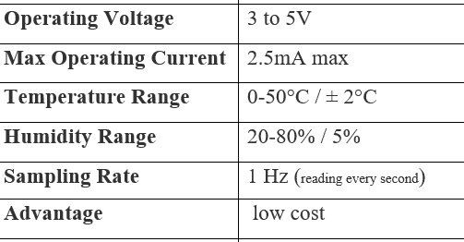
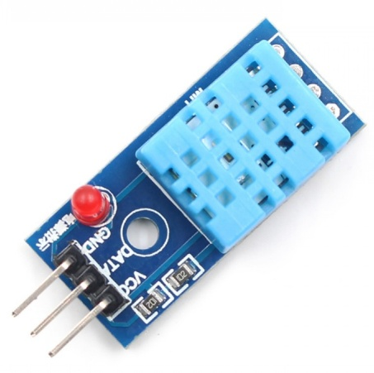
DHT11
The DHT11 is a basic, low-cost digital temperature and humidity sensor. It uses a capacitive humidity sensor and a thermistor to measure the surrounding air, and spits out a digital signal on the data pin (no analog input pins needed). It’s fairly simple to use, but requires careful timing to grab data. The only real downside of this sensor is you can only get new data from it once every 2 seconds.
#define DHT11_PIN 4
GRTIET, Department of Electronics and Communication Engineering

Slide 21
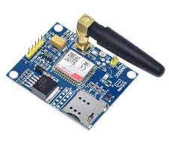
GSM
SIM800C is a widely used GSM Module with a serial interface modem which runs in between 3.4V-4.4V Voltage level. SIM800C is a Quad-band GSM/GPRS Module which is used in embedded applications where the remote data transfer is required. SIM800C works on 850/900/1800/1900MHz.GSM – used to send the information to municipality
Small size quad-band GSM/GPRS module
LCC form factor, easy for solder
Abundant software functions: DTMF, MMS, MUX
Low Power consumption
#define GSM_RX_PIN 9
#define GSM_TX_PIN 10
GRTIET, Department of Electronics and Communication Engineering

Slide 22
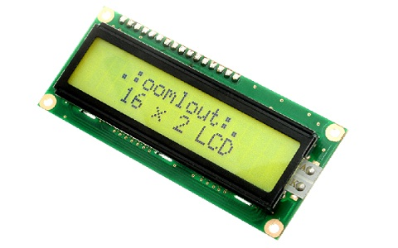
LCD
The liquid crystal display (LCD) panel is designed to project on-screen information of a microcomputer onto a larger screen with the aid of a standard overhead projector
Parameter | Value
Operating Voltage | 4.7V-5.3V
Operating Current | 1mA with no backlight
Controller | HD47780
Number of columns | 16 each row, total 16 x2 = 32 columns
Number of rows | 2
Number of Character | 32
Character font-size | 0.125″W x 0.200″H
Work Modes | 4-bit & 8-bit
Backlight LED color | Blue or Green
Number of Pins | 16
Module PCB Size | 80 x 36 x 10 (LxWxH) mm.
GRTIET, Department of Electronics and Communication Engineering

Slide 23
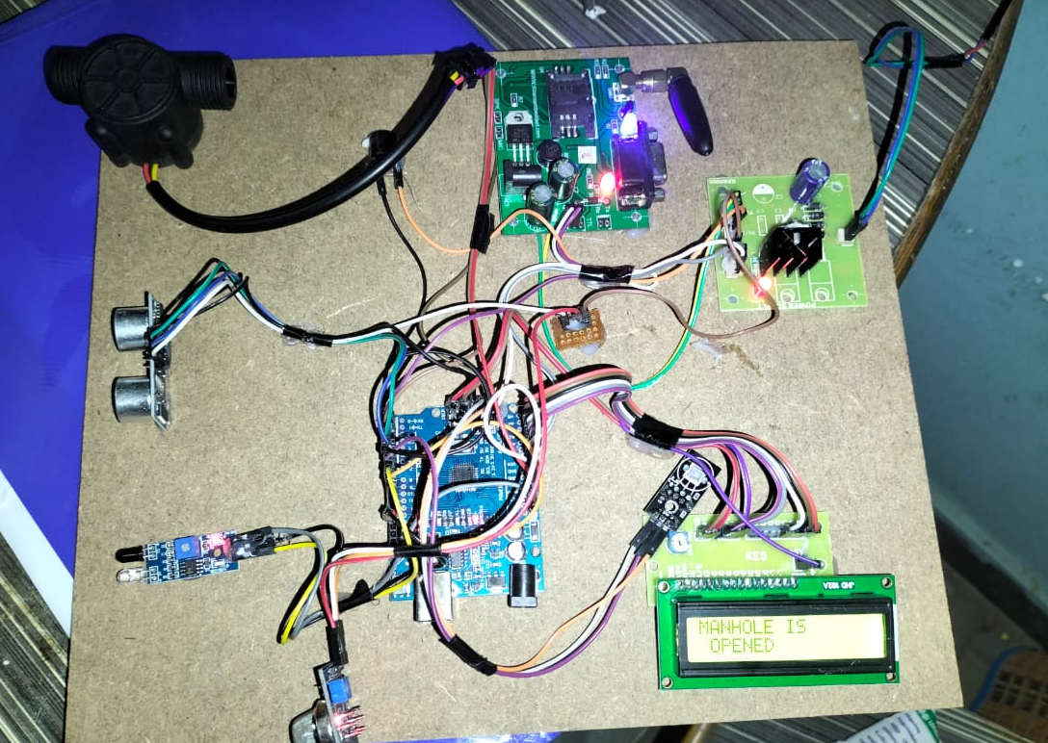
EXPERIMENT TESTING
GRTIET, Department of Electronics and Communication Engineering

Slide 24
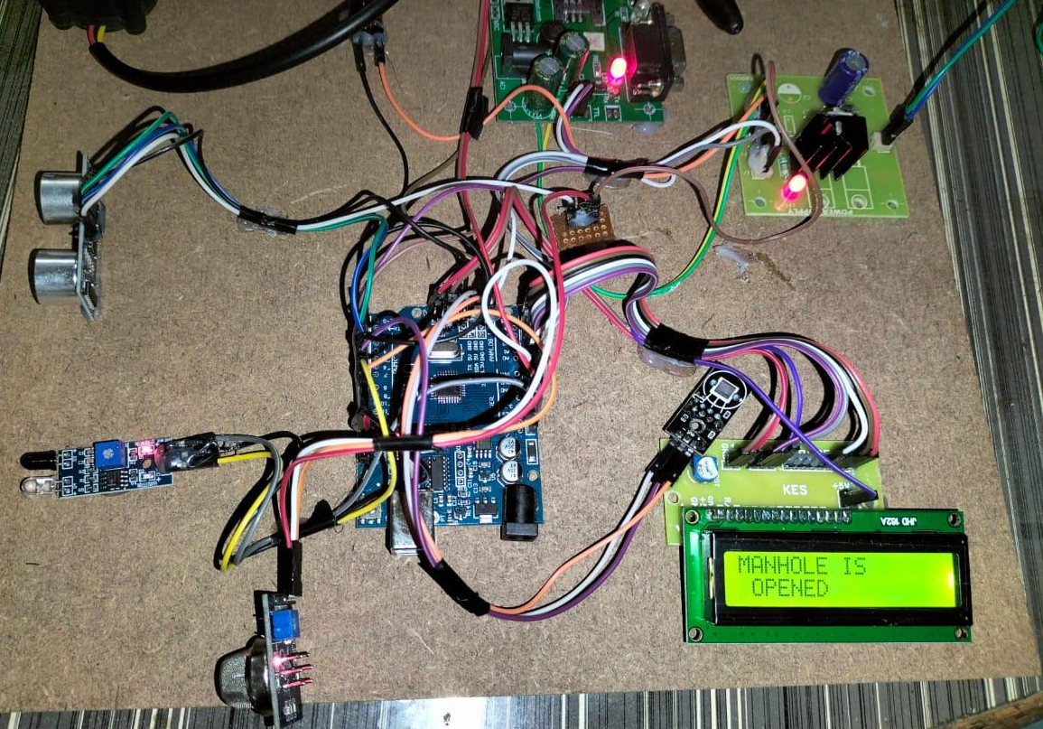
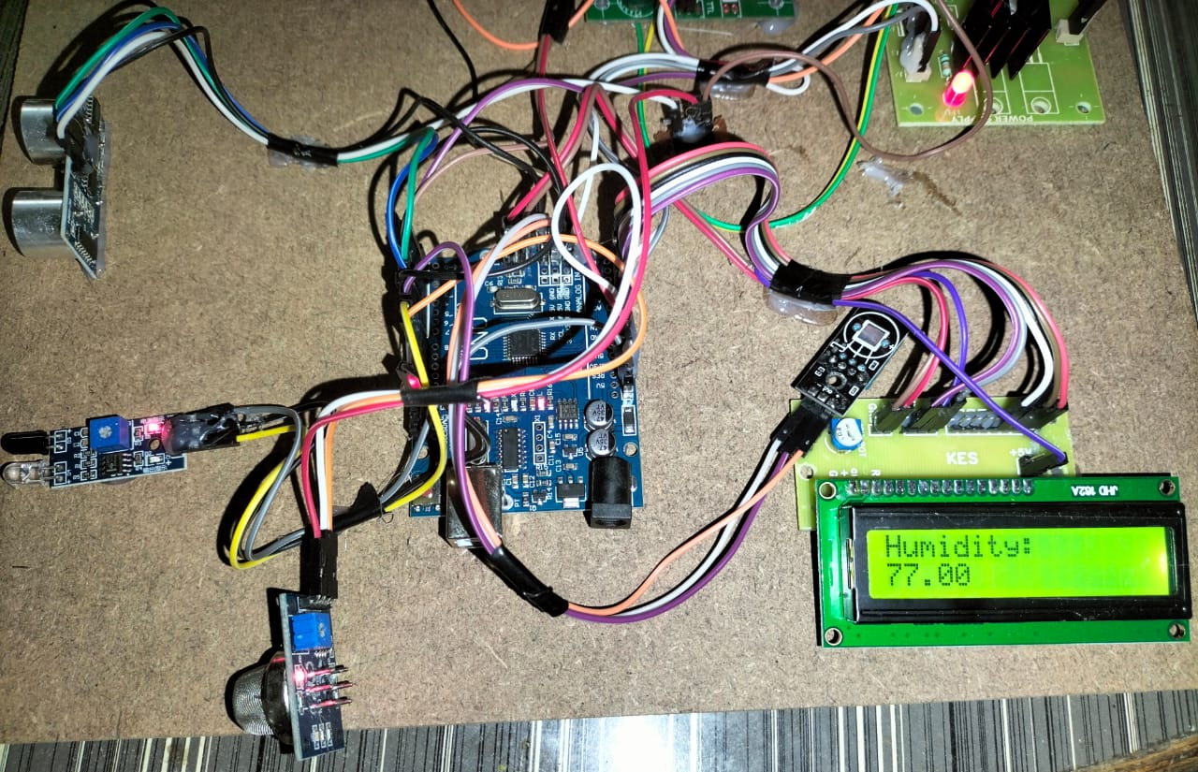
HARDWARE TESTING
It displays if the manhole is open or closed.
It displays the humidity level of manhole
GRTIET, Department of Electronics and Communication Engineering

Slide 25
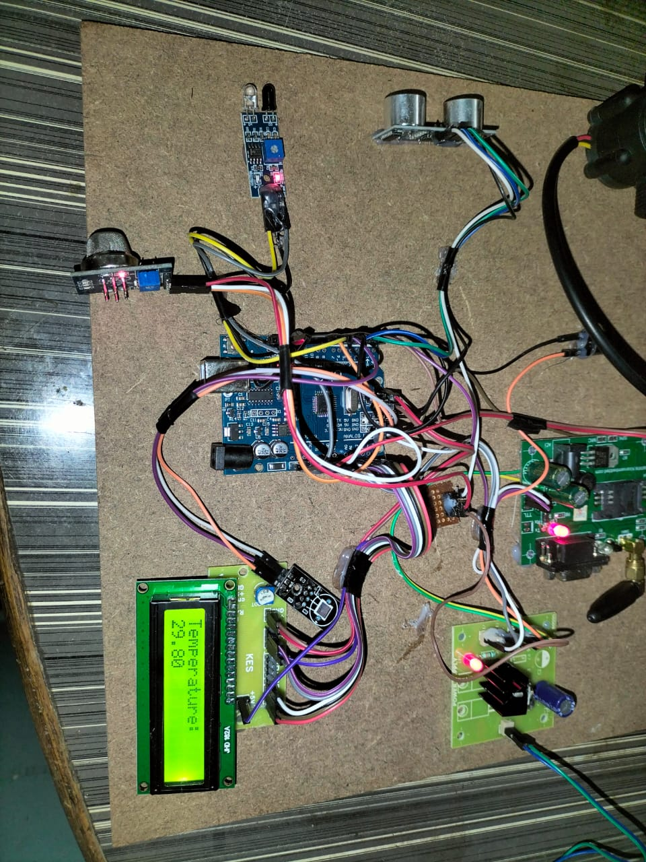
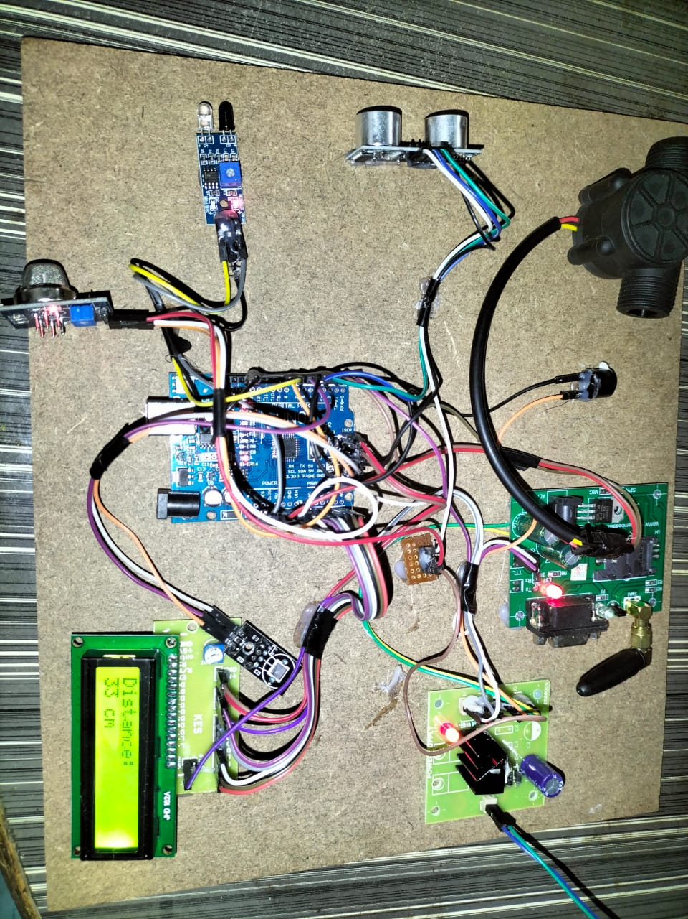
HARDWARE TESTING
It displays the Temperature of manhole
It displays the Water level of Manhole
In CM.
GRTIET, Department of Electronics and Communication Engineering

Slide 26
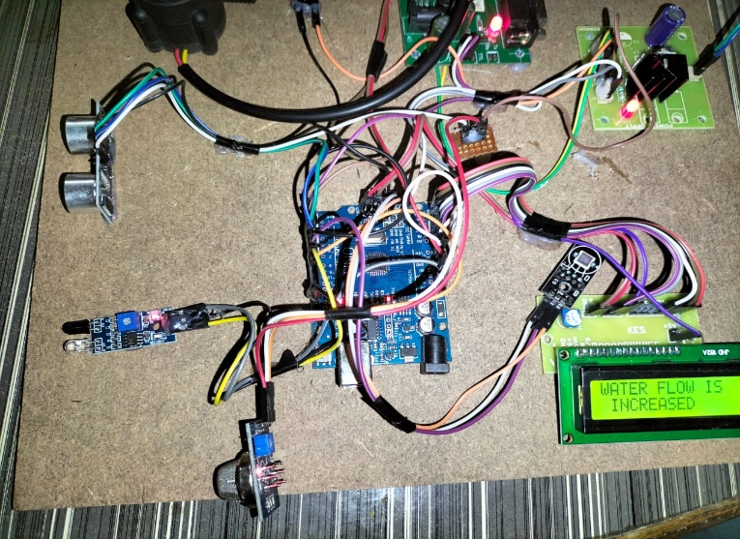
HARDWARE TESTING
Here, we developed a new flow sensor for monitoring the flow of Drinage water, which would halt the flow in case it was obstructed.
GRTIET, Department of Electronics and Communication Engineering

Slide 27
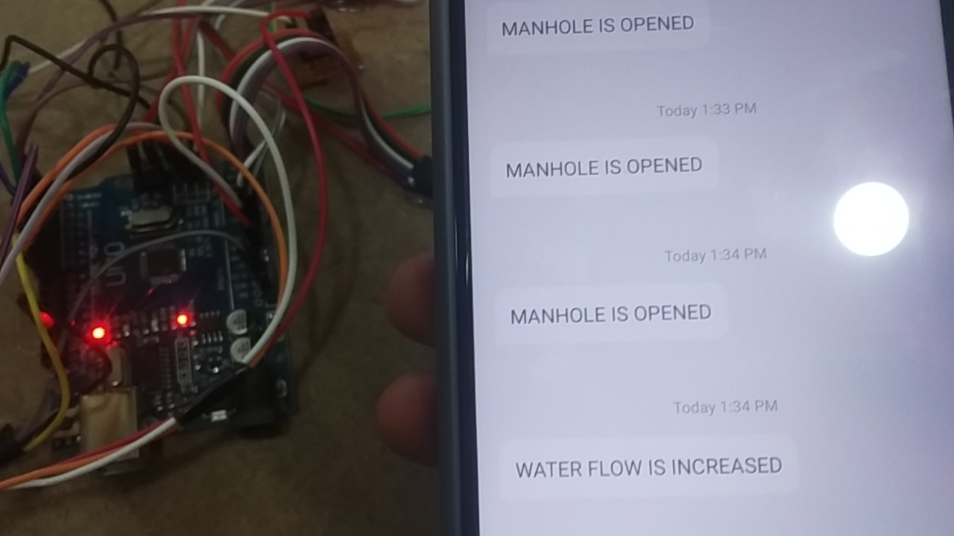
SOFTWARE TESTING
The data collected from the device can be sent to the authorities through GSM at a time when he can act immediately. with no internet troubles
GRTIET, Department of Electronics and Communication Engineering

Slide 28
ADVANTAGES
Reduces human effort.
Saves time and fuel consumption.
Flow of water can monitor.
Monitors the garbage bins and informs about the level of garbage collected in the garbage bins.
To keep our Environment clean & green.
The cost & effort are less in this system.
GRTIET, Department of Electronics and Communication Engineering

Slide 29
APPLICATIONS
This project can also be used in the” SMART CITY”.
This project is also helpful in the government project of “SWACHH BHARAT ABHIYAN”.
GRTIET, Department of Electronics and Communication Engineering

Slide 30
FUTURE SCOPE
Machine Learning: Incorporating machine learning algorithms to the system can improve its efficiency and accuracy in detecting issues with the manhole cover. By analyzing data collected over time, machine learning models can predict potential problems before they occur.
Energy Harvesting: Using energy harvesting technologies such as solar panels or kinetic energy harvesting can power the sensors and devices used in the system. This can reduce the dependence
Artificial Intelligence (AI) Integration: AI algorithms can be integrated with the system to analyze the data collected by the sensors and provide insights on trends and patterns.
GRTIET, Department of Electronics and Communication Engineering

Slide 31
CONCLUSION
The Manhole monitoring needs to be cleaned when it is filled to maintain a hygienic environment. Our manhole monitoring system contains Arduino, Ultrasonic sensor, IR. The system monitor the manhole level and it reaches the particular level it sends the notification and if manhole is open then notification alert. This notification system helps the municipality to monitor the opening of manholes. If the drainage wastes are not cleaned it sends the message to higher authority. Our model overcomes the entire problem in smart manhole alert.
GRTIET, Department of Electronics and Communication Engineering

Slide 32

ANY QUERIES….??
GRTIET, Department of Electronics and Communication Engineering

Slide 33
THANK YOU….!
GRTIET, Department of Electronics and Communication Engineering

